Slide 1


Exploring Disease States and Mortality Rates (SQL and Tableau)
Jeremy Olson

Slide 2
An Explanation of Our Files
Population: https://www.census.gov/data/datasets/time-series/demo/popest/2010s-state-total.html
Leading Causes of death - https://catalog.data.gov/dataset/nchs-leading-causes-of-death-united-states-2c730
Obesity - https://catalog.data.gov/dataset/national-obesity-by-state-e483a for obesity (2015 data) - The last column was deleted before import
This project is written in PostgreSQL. Some of the syntax may reflect this
Notes:
Population data underwent some transposing to have one row per year
Obesity data is from 2015. Last row was deleted before uploading into SQL.

Slide 3
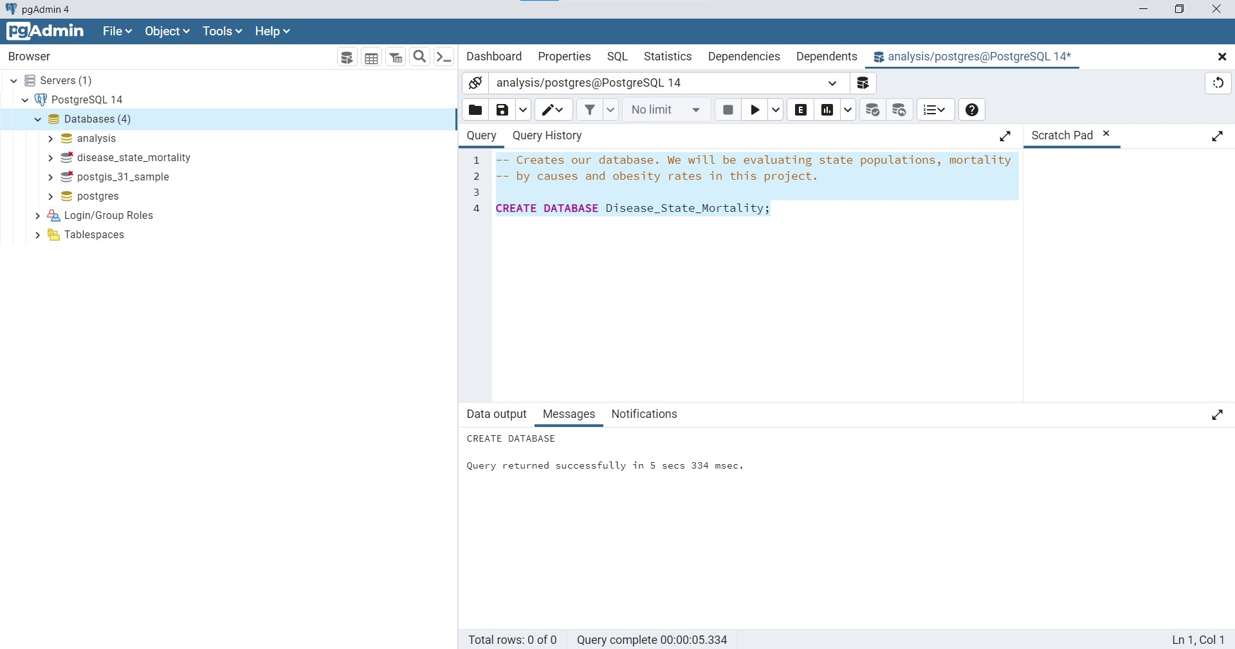
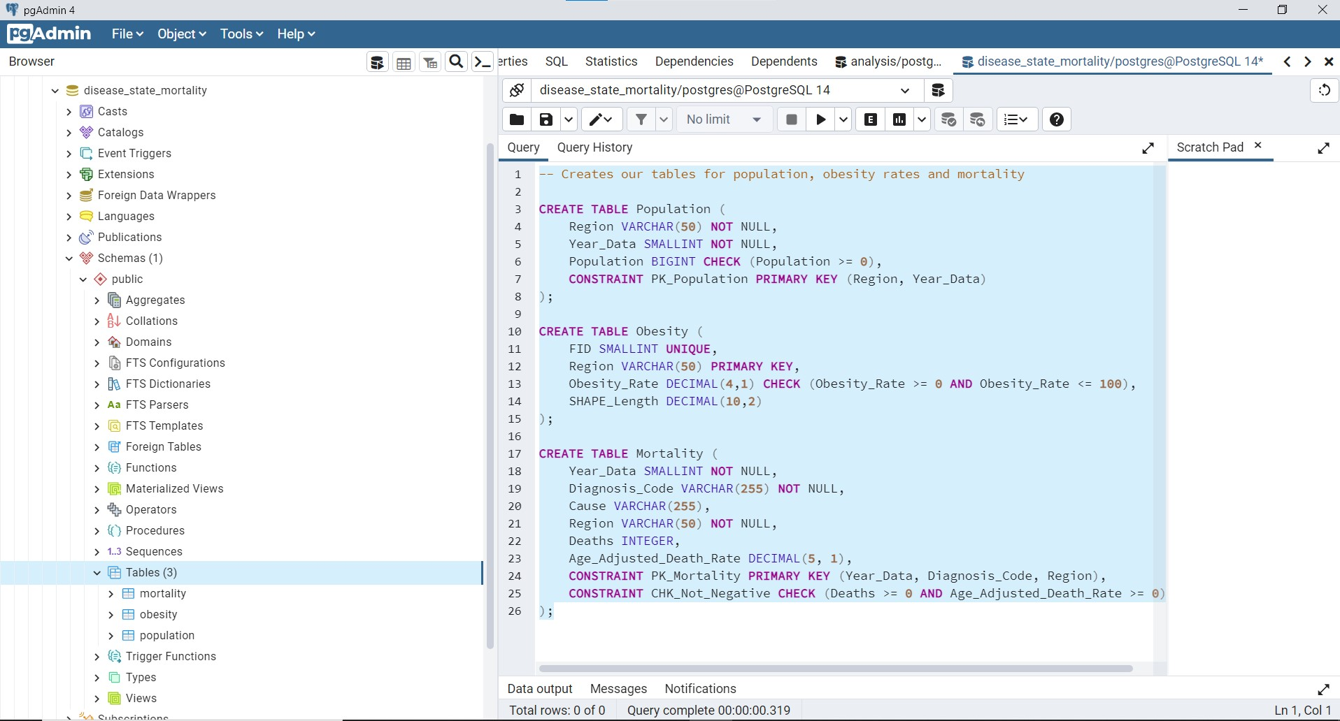
Create Our Database and Tables

Slide 4
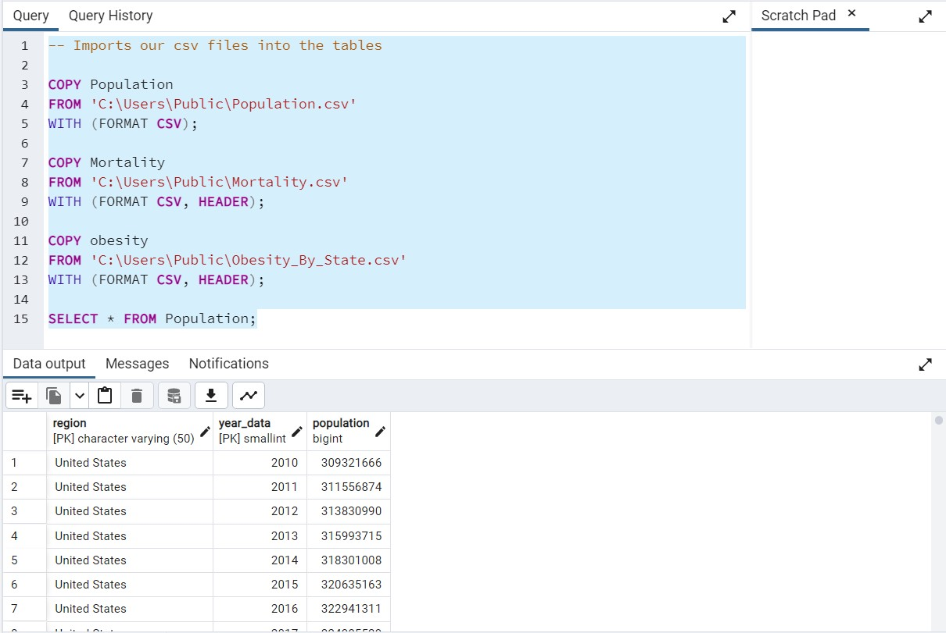
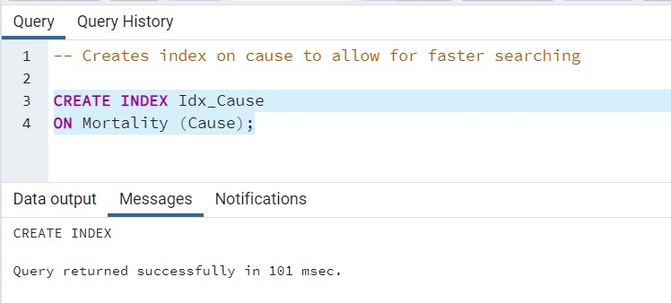
Import our CSV files
I do believe the copy statements are PostgreSQL syntax.
An Index was created on cause

Slide 5
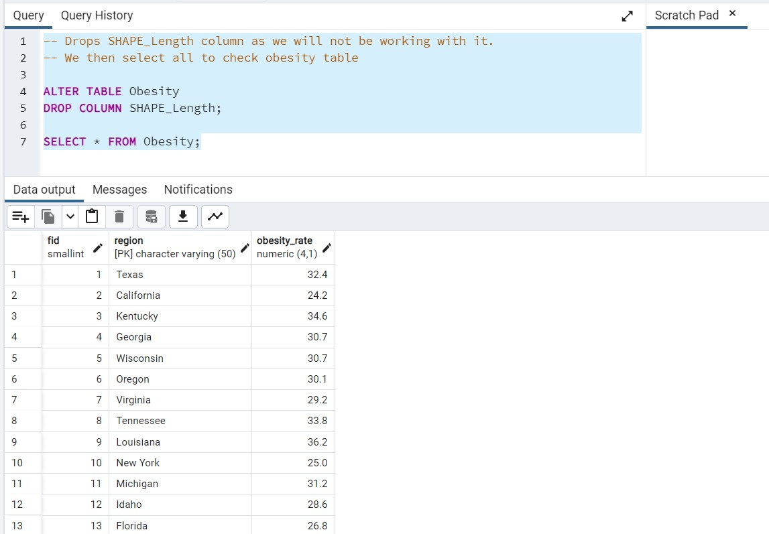
Data Cleaning: Drop Column
I do not intend to use the SHAPE_Length column in Obesity, so we will drop it here

Slide 6
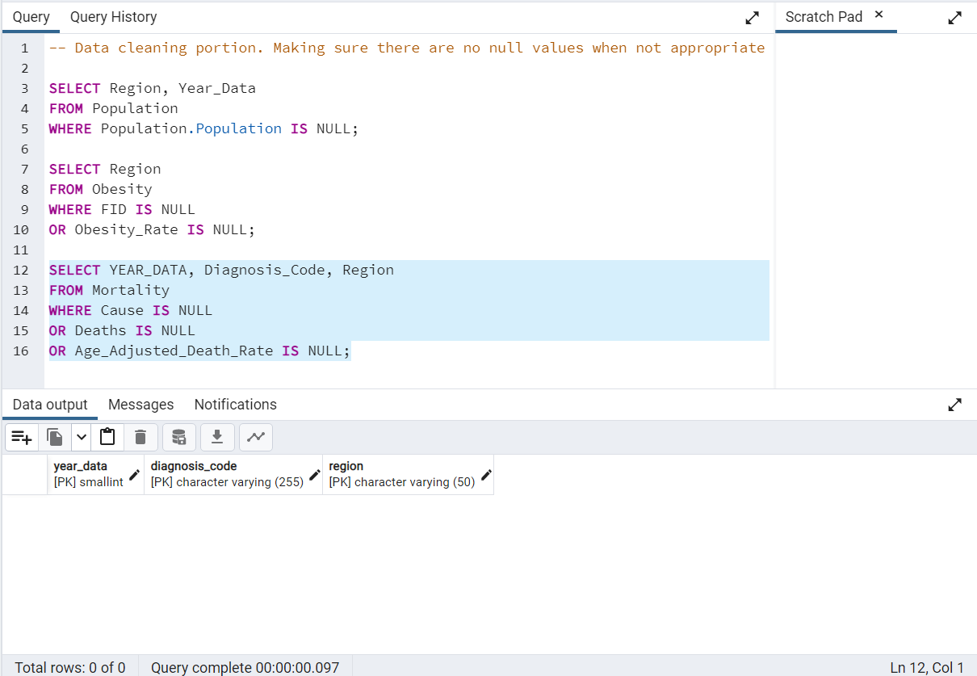
Data Cleaning: Null Values
Here we check if any important values (not already specified as NOT NULL or PRIMARY KEY in our tables) are null after import. All queries returned NULL (No null values in our table).

Slide 7
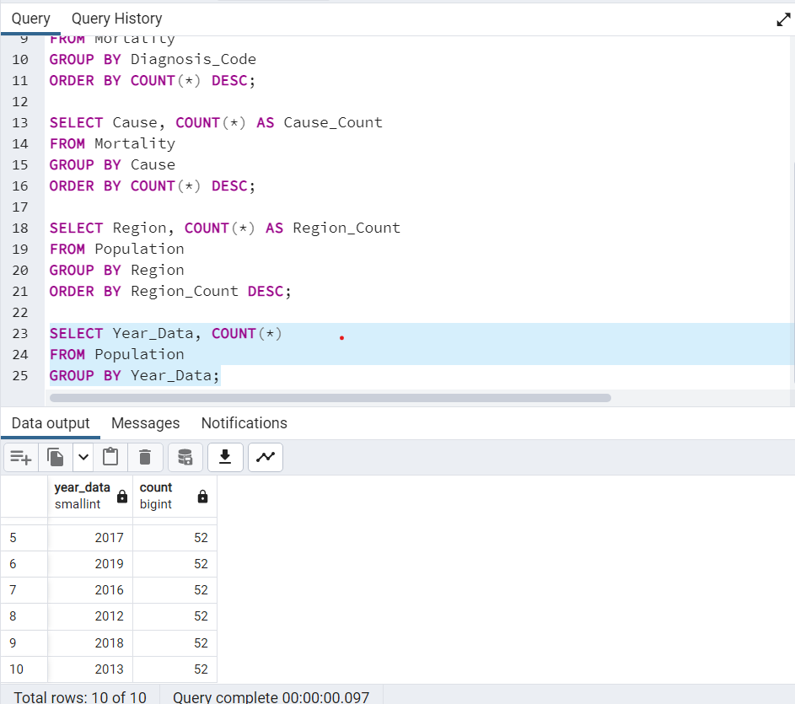
Data Cleaning: Checking for Typos
Here we select all regions, diagnosis codes, year_data and causes to see if there are any typos
All of our queries returned equal counts for each year, region, cause, diagnosis code, etc. We would expect these all to be equal on a successful import.

Slide 8
Data Cleaning
After examining the queries, each table has the values expected, and the same amount as other tables, as expected.
I do not anticipate this always happening in my career, but thanks to Census.gov and data.gov, it appears we have obtained completely clean data!

Slide 9
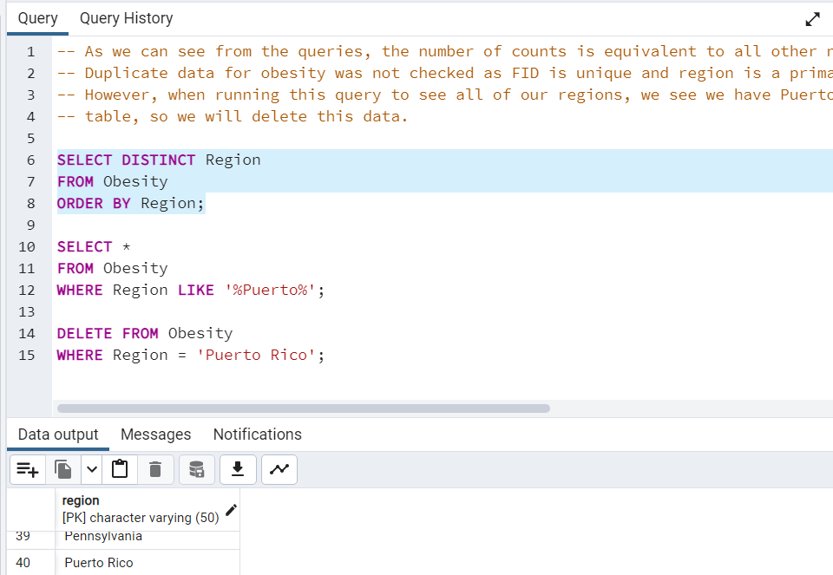
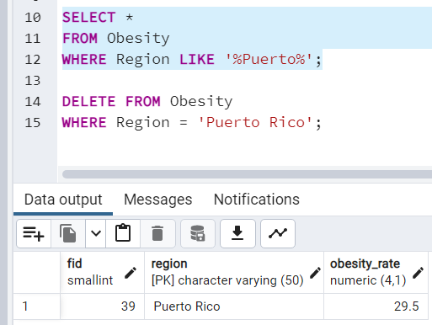
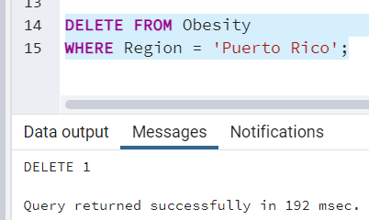
Deleting Puerto Rico From Our Table
We only have Puerto Rico in our obesity table currently, so we will delete that row here

Slide 10
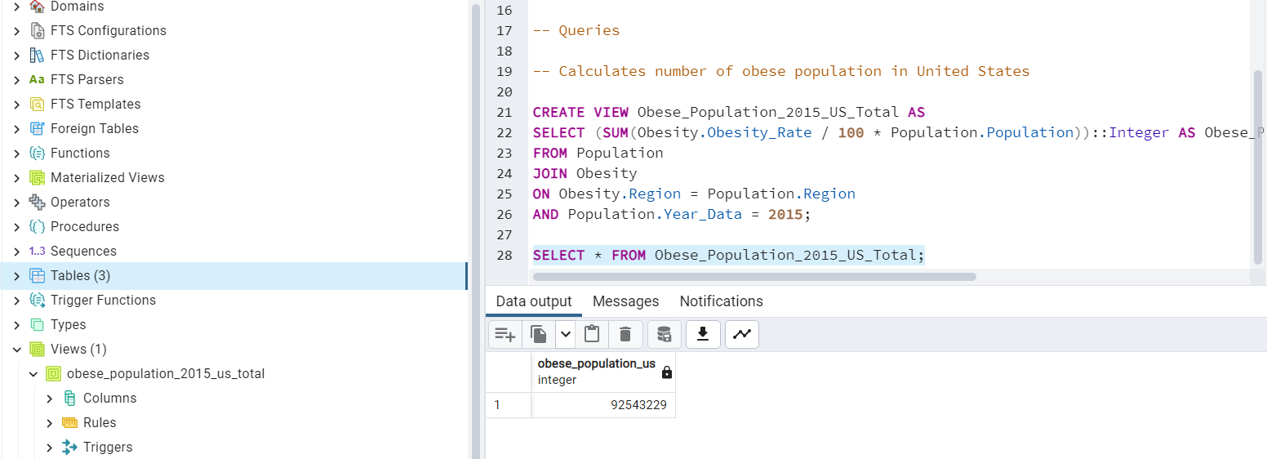
Queries: Calculating Obese Population

Slide 11
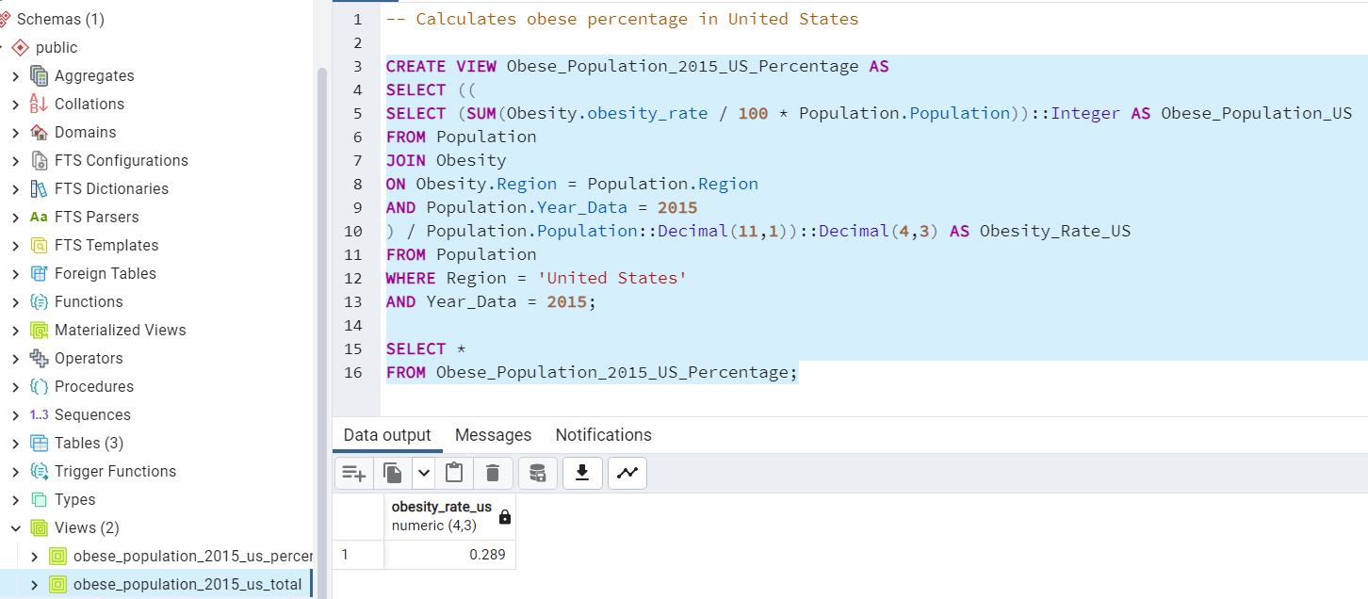
Queries: Calculating Obesity Percentage for US (From our State Data)
0.289

Slide 12
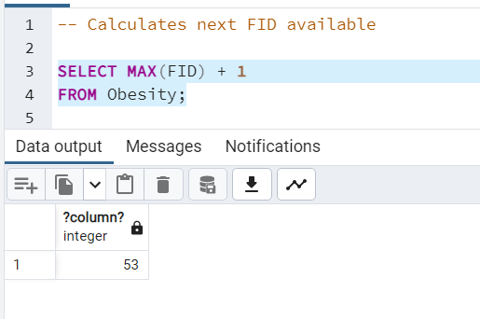
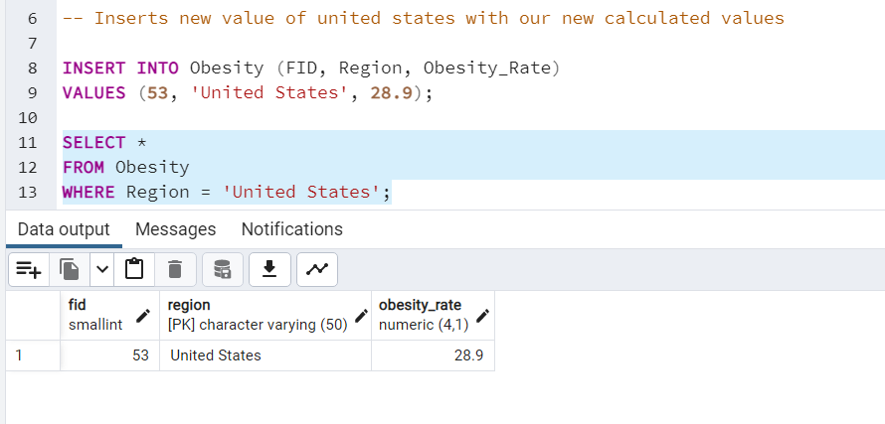
Queries: Inserting US Obesity Rate Into Obesity Table

Slide 13
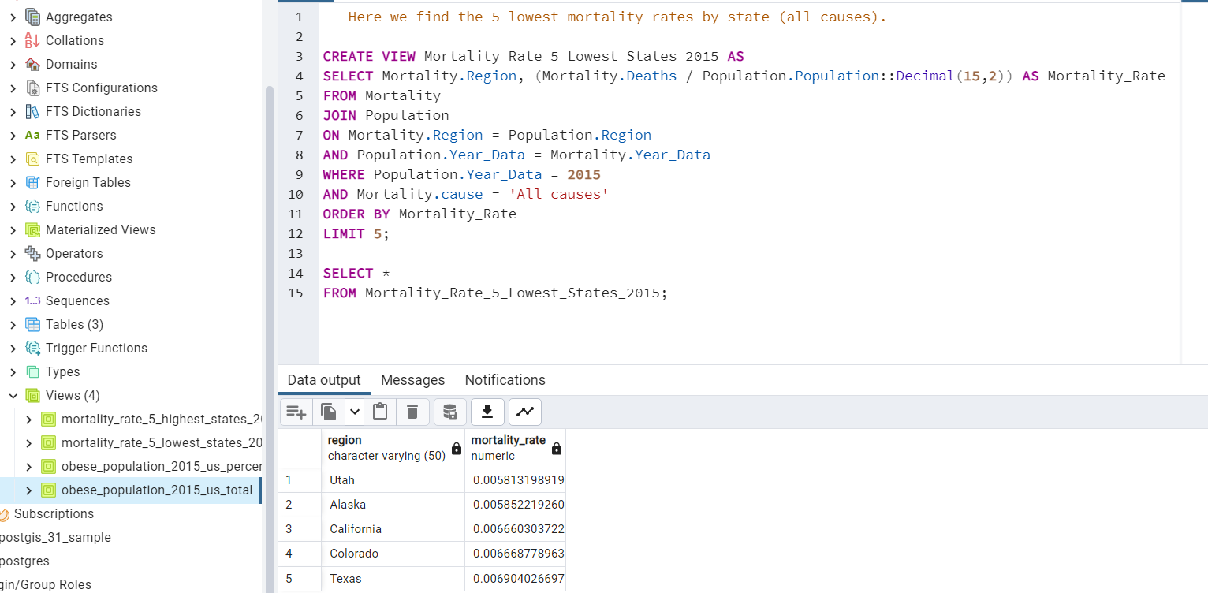
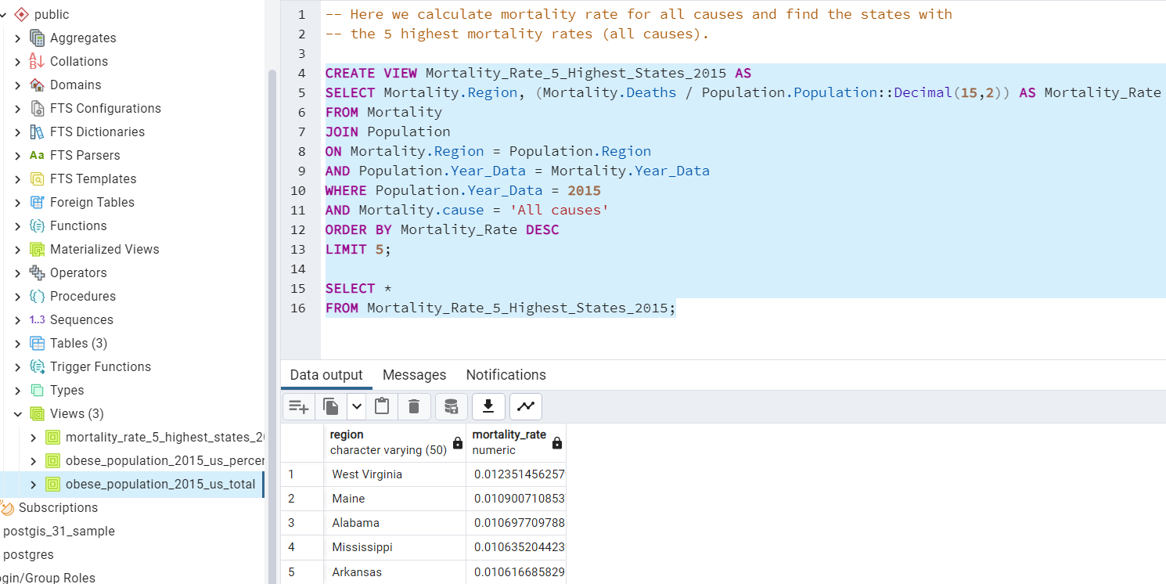
Queries: Finding 5 States with Highest and Lowest Mortality Rates (2015)

Slide 14
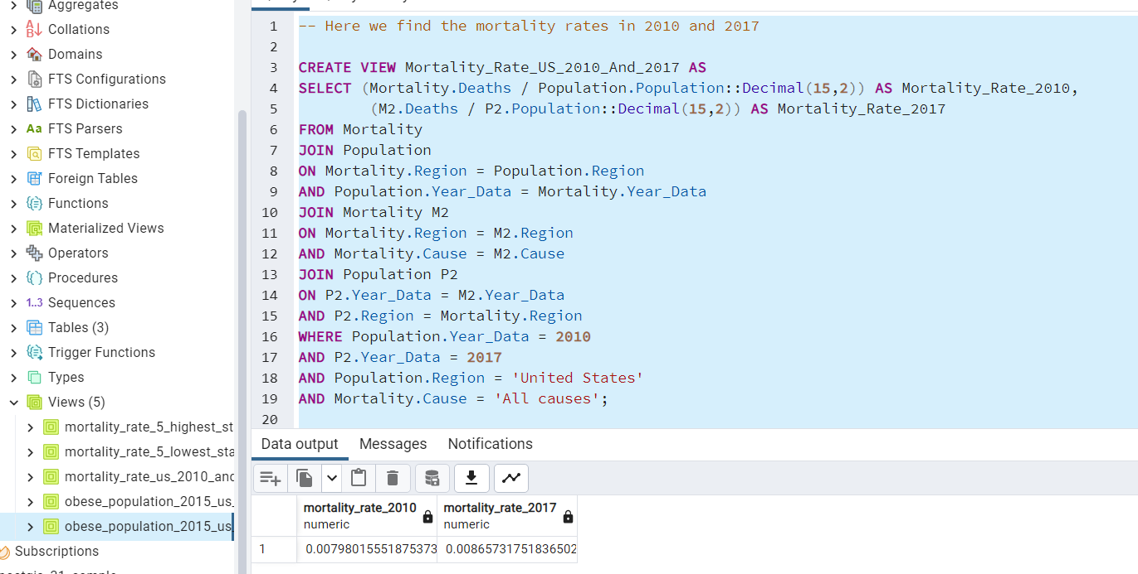
Queries: Finding Mortality Rate for year 2010 and 2017
I also did this query while changing the years from 2010 to 2017
Interestingly enough, there was a steady and slow increase in mortality rate from 2010 and 2017.

Slide 15
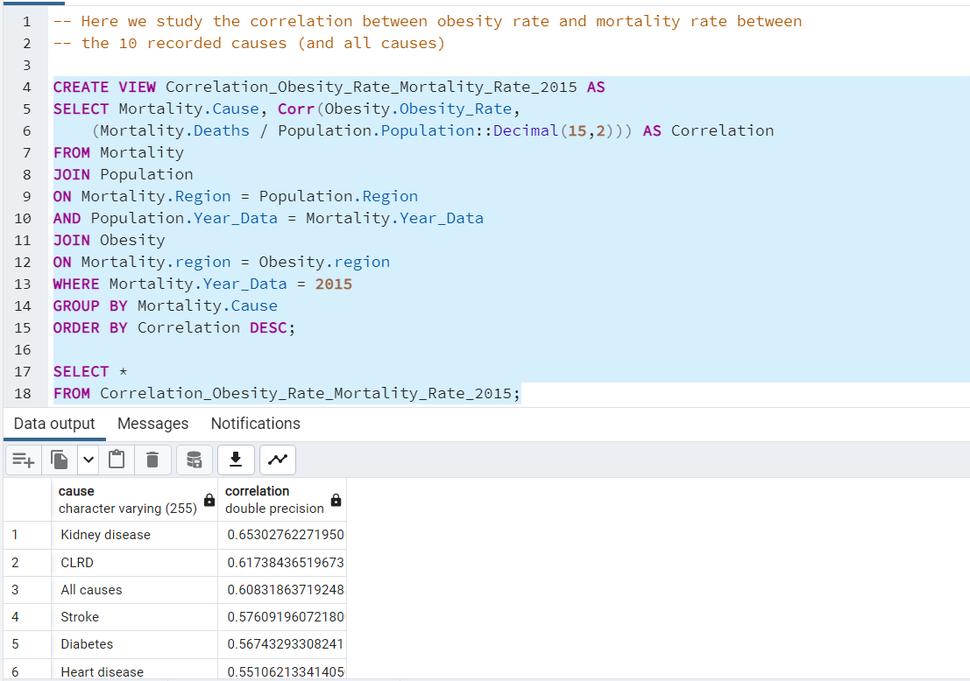
Queries: Correlation Between Obesity Rate and Mortality Rate
This query is grouped together by cause.
The Disease state deaths were most correlated with obesity were kidney disease and clrd (Chronic Lower Respiratory Disease). It is difficult to make a full evaluation from here, however. We do not know how many kidney disease patients have obesity for example.

Slide 16
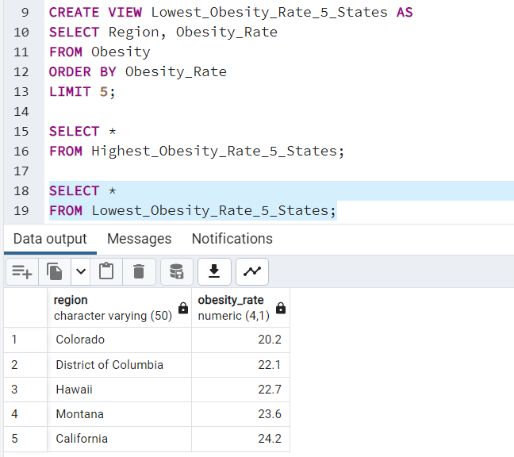
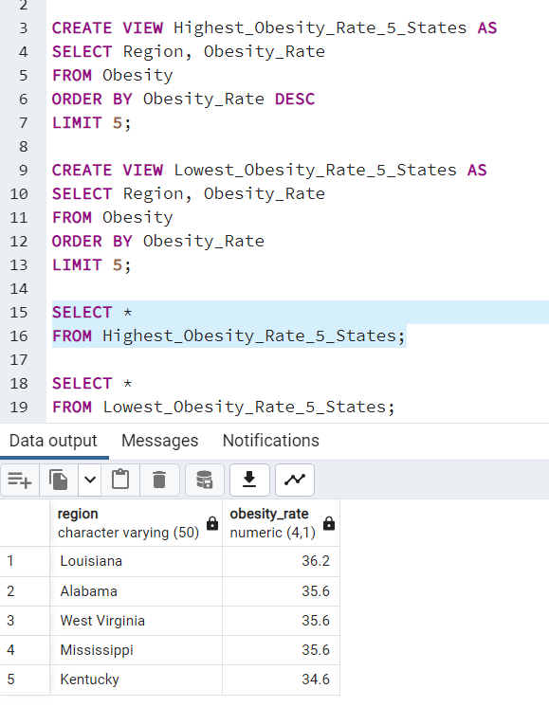
Queries: 5 States with Highest and Lowest Obesity Rates

Slide 17
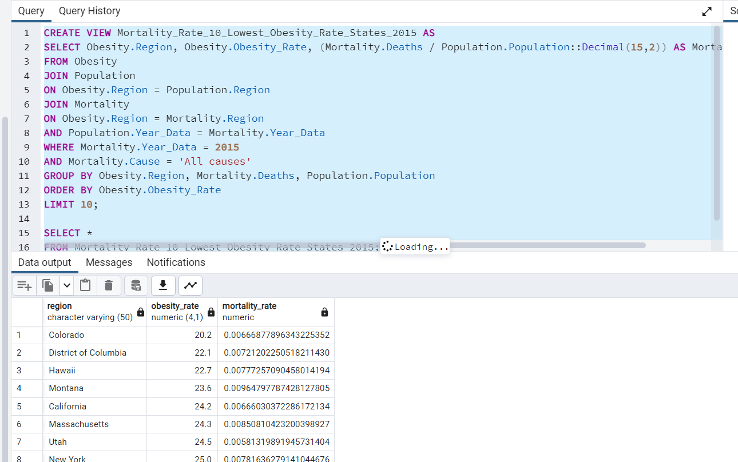
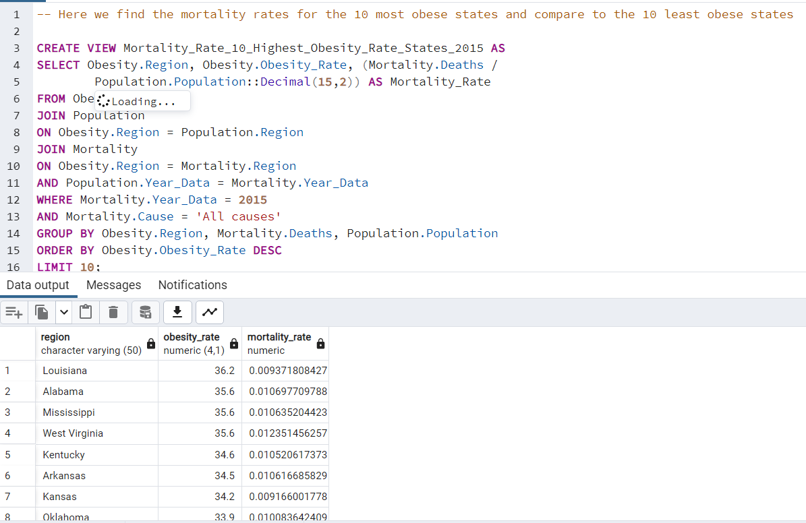
Queries: Finding Mortality Rate for States With Highest and Lowest Rates of Obesity
As we can see, Mortality rate is noticeably lower in less obese states (although Montana seems relatively high).
This does not take into consideration other confounding factors like average age of states

Slide 18
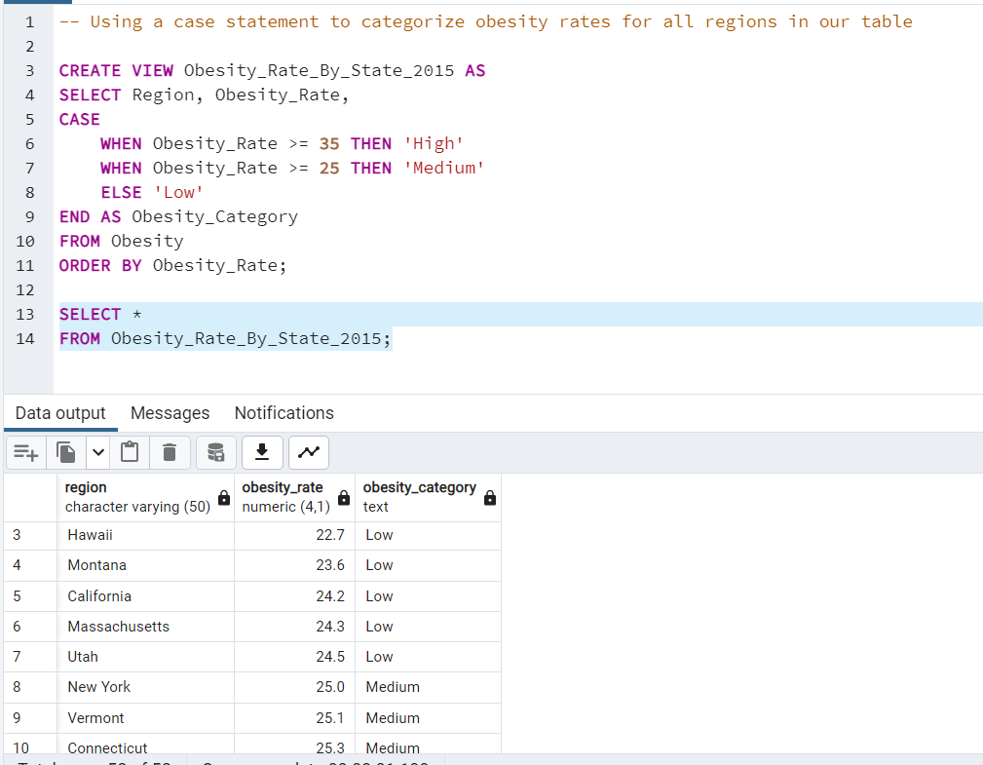
Queries: Case Statement Obesity Rate Classification

Slide 19
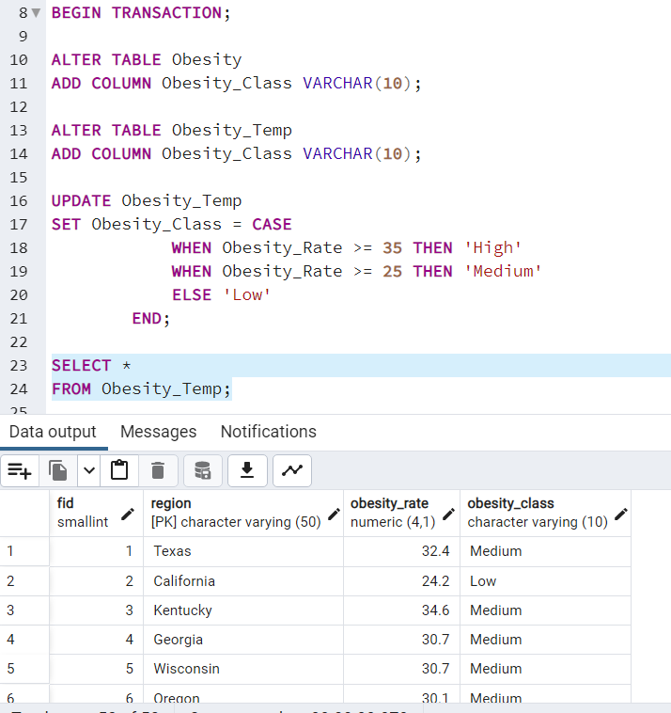
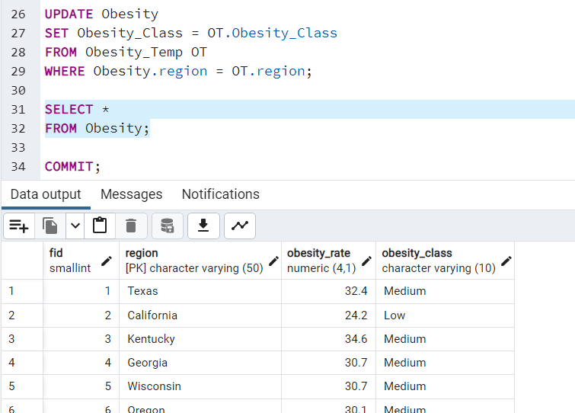
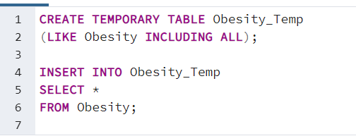
Queries: Updating Obesity Class Using Temp Table / Transaction

Slide 20
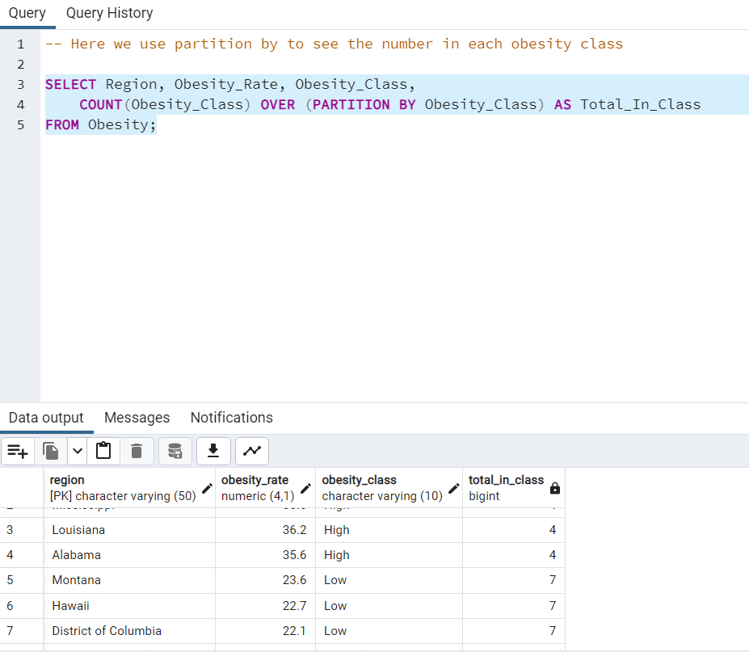
Queries: Partition By to Find Number in Each Obesity Class
I do think there may be some interesting queries around obesity_class, so we made it a column
Here we used a partition statement to see total number of states in my self-defined classes

Slide 21
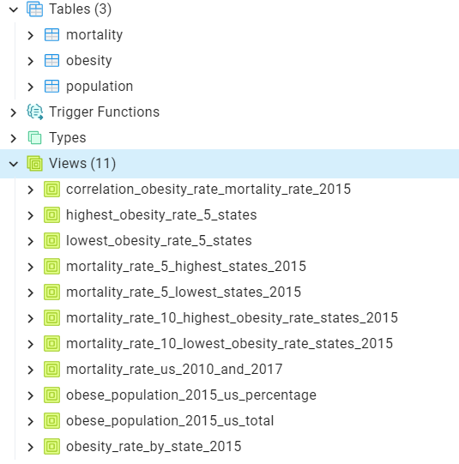
End Results
3 tables and 11 views

Slide 22
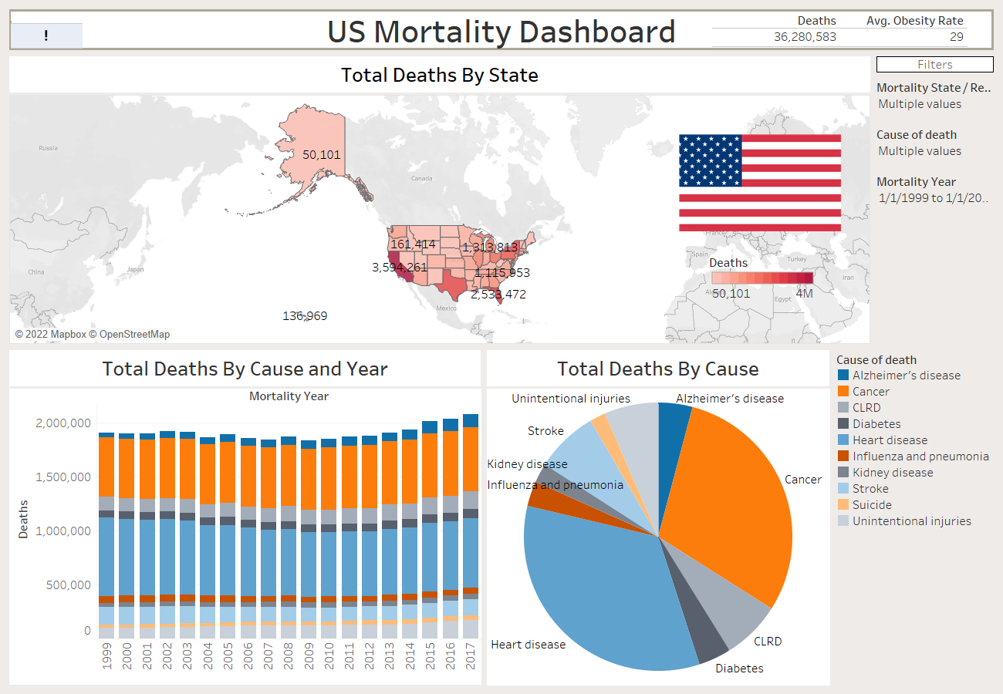
Visualizations in Tableau
To visualize some of this information, a dashboard in Tableau was created
If interested in the full filter functionality, please see the .twbx file

Slide 23
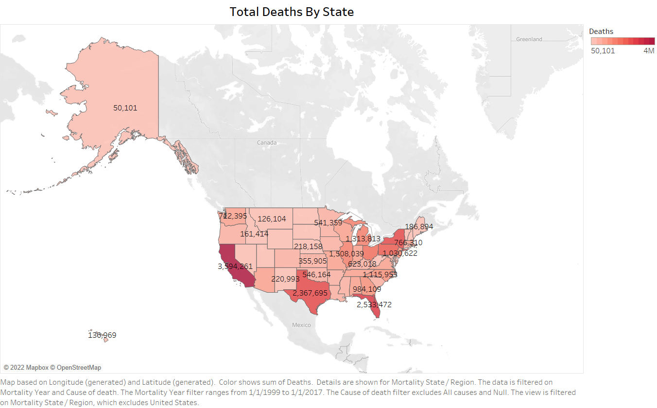

Slide 24
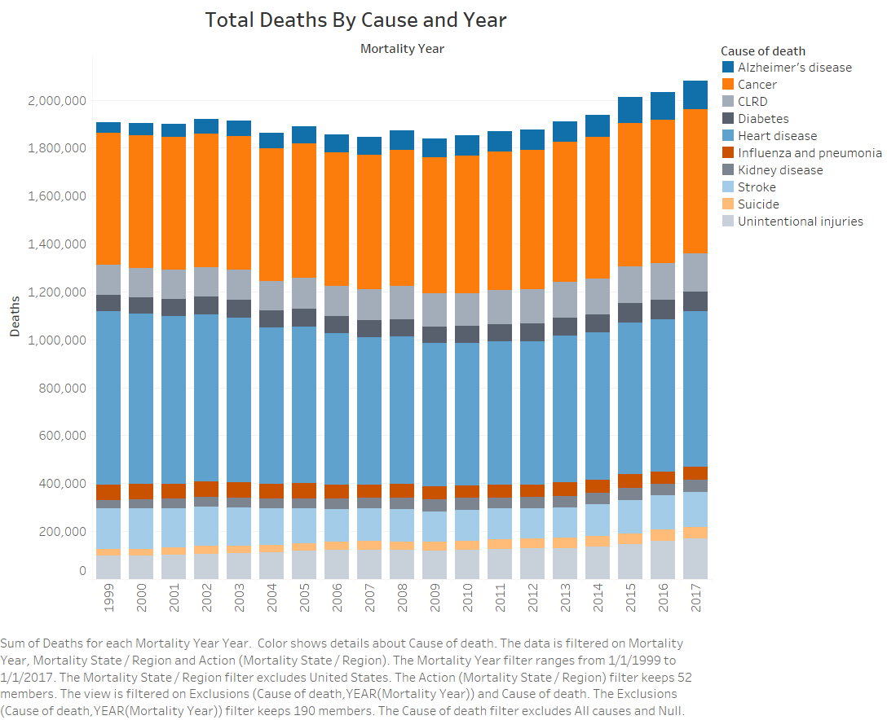

Slide 25
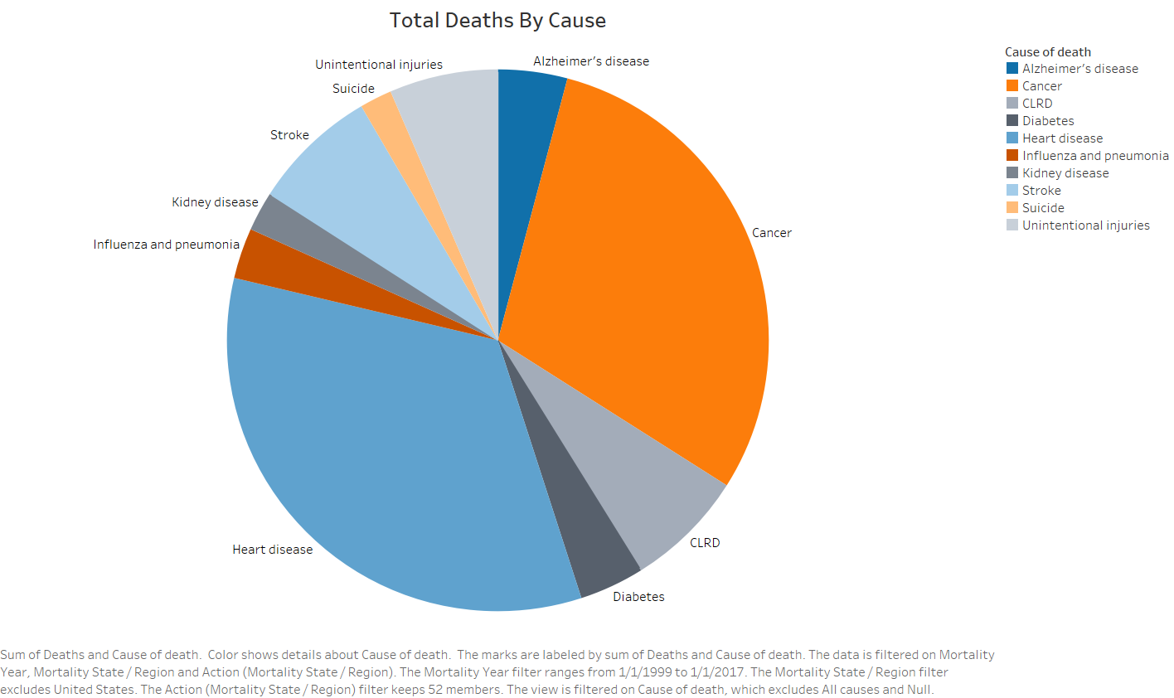

Slide 26
